Slide 1

Renty
Intelligent P2P Rental Platform
Yasser Ashraf
Ahmad Khlifa
Moamen Ahmed
Hamza Hussain
Moaz Moustafa
AbdulRahman Hesham
Supervised By:
Prof. Dr. Mohamed Khamis

Slide 2
Agenda

Slide 3
Problem Statement

Slide 4
Problem Statement
Why This Matters
No Solution Exists in EgyptNo Solution Exists in Egypt
Equipment is expensive to own
— A climbing set costs 4,000–10,000 EGP
Platform | Rental? | Trust? | Escrow?
Dubizzle (OLX) | No | No | No
Facebook(Groups) | No | No | No
Renty | Yes | Yes | Yes
No trust between strangers
— Cash deals on Facebook groups with zero protection
Tourists can't travel with gear
— Sports tourists in Dahab, Sinai, Red Sea need local access
Equipment sits idle
— Owners have gear collecting dust 80% of the year

Slide 5
Market Focus

Slide 6
MARKET FOCUS
Climbing
Water Sports
Cycling
50K+ active climbers in Egypt
High-value gear (500–2,000 EGP per item)
Seasonal peaks: Spring & Fall
Strong communities (Cairo Rock Club)
Red Sea, Dahab, Sinai coast
International sports tourism
Premium pricing possible
Seasonal: Summer peak
80K+ cyclists nationwide
High repeat rental potential (weekends)
Growing infrastructure
We focus on sports equipment first because: high item value = justified deposits, passionate communities = early adopters, seasonal demand = predictable revenue, and tourist market = English language justified

Slide 7
Business Model

Slide 8
Business Model
Platform Commission
Expert Verification Model
Payment
Processing
15% of every rental fee
Primary revenue (70%)
50–100 EGP per inspection
Secondary revenue (20%)
1–2% gateway margin
Tertiary revenue (10%)
Owner receives 1,190 EGP (85%)
RENTY keeps 210 EGP (15%)
Renter Pays 1,400 EGP
RENTY Escrow
Deposit 500 EGP returned after rental

Slide 9
Platform Features

Slide 10
Platform Features
Secure Rentals
Expert Verification
Smart Recommendations
Escrow payments
+
deposit protection
ML-powered personalized suggestions
Physical inspection at Renty Hubs
Real-time Chat
Fraud Detection
Gap Analytics
SignalR instant messaging
Behavioral anomaly scoring
Supply-demand intelligence
Multi-platform
Admin Dashboard
Dispute Resolution
Angular Web + Flutter Mobile
KPIs, user management, moderation
3-tier escalation system

Slide 11
How it works

Slide 12
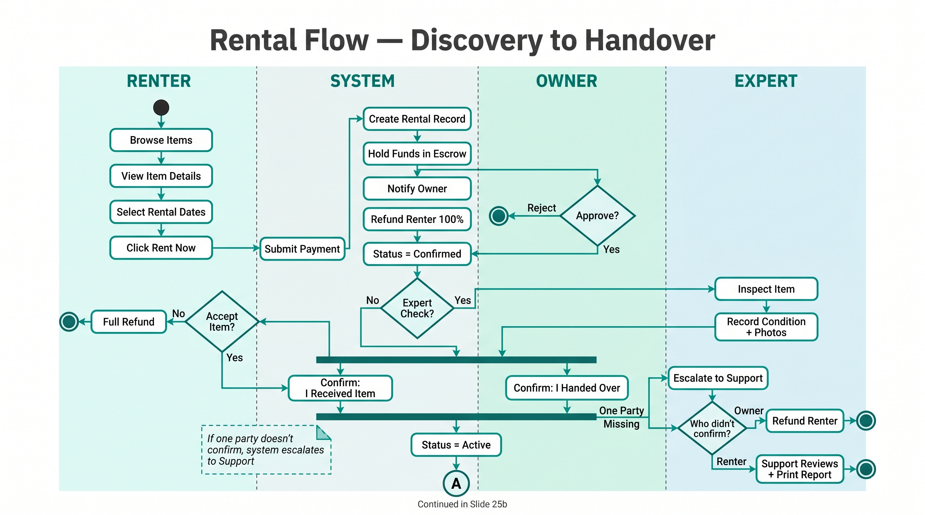
How it works

Slide 13
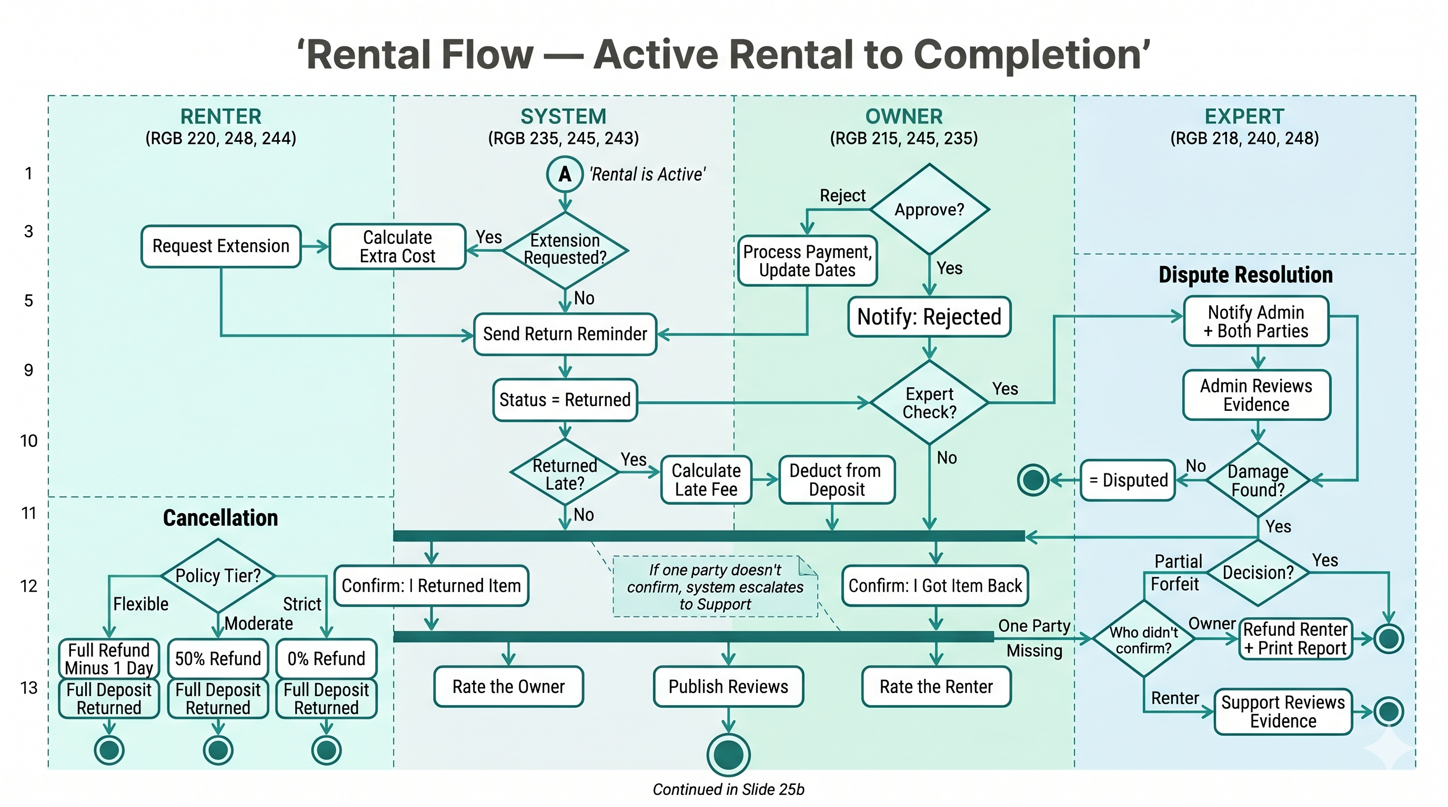
How it works

Slide 14
System Architecture

Slide 15
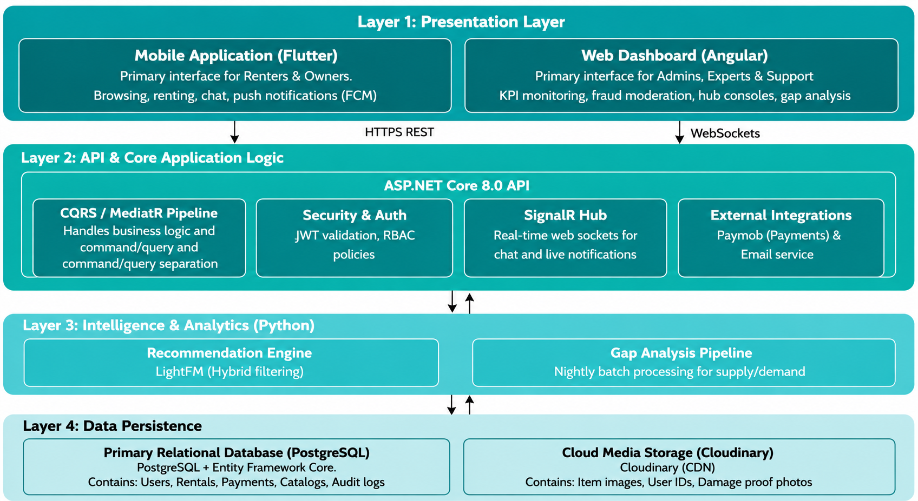
System Architecture

Slide 16
Tech Stack

Slide 17
Tech Stack
ML / Analytics
Frontend
Backend
Python 3.11
LightFM 1.17 (RS)
scikit-learn 1.4 (Fraud)
pandas 2.2 (Gap Analysis)
Angular 19 (Web)
Flutter 3.x (Mobile)
Dart (Mobile language)
Chart.js (Visualization)
ASP.NET Core 8.0
Entity Framework Core 8.0
MediatR 12 (CQRS)
FluentValidation 11
SignalR (WebSockets)
BCrypt.Net (Security)
Infrastructure
PostgreSQL 16
Cloudinary (CDN)
Paymob (Payments)
JWT + RBAC (Auth)

Slide 18
Database Design

Slide 19
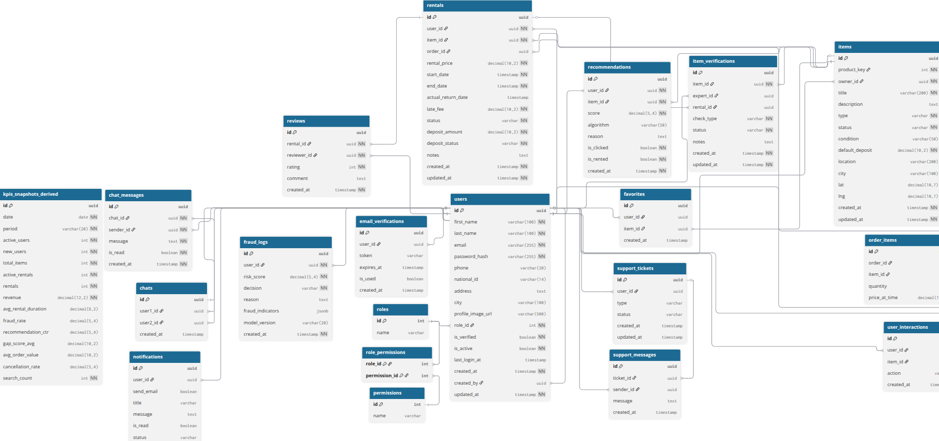
Database Design
27 tables | 150+ columns | Full referential integrity

Slide 20
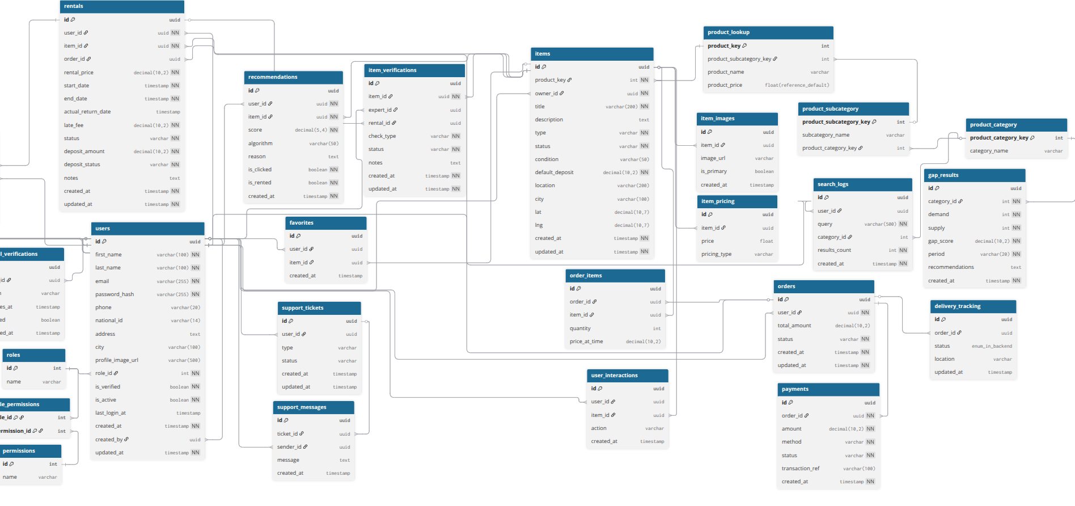
Database Design
27 tables | 150+ columns | Full referential integrity

Slide 21
Semester 1 Recap

Slide 22
Semester 1 Recap
Recommendation System
Gap Analysis
Hybrid collaborative filtering using LightFM
Trained on 55,666 transactions
Achieved 0.8421 AUC (+12.3% vs baseline)
Fraud Detection
Supply-demand scoring pipeline
4 severity tiers (Low to Critical)
Weekly batch processing for trend tracking
Unsupervised anomaly detection using Isolation Forest
16 behavioral features engineered
Configurable risk threshold (default 0.75)
All three modules were researched, designed, and prototyped in Semester 1. Semester 2 integrated them into the production platform.

Slide 23
Recommendation
System

Slide 24
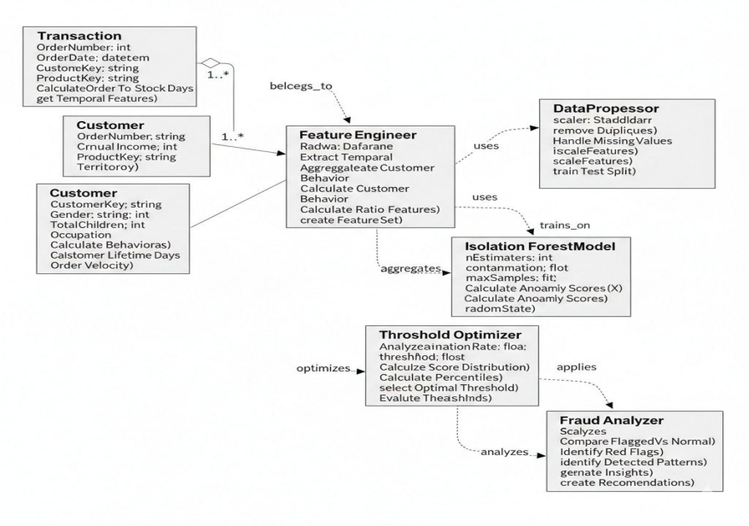
Recommendation System
Results
AUC: 0.8421 (+12.3% vs baseline)"
"Precision@10: +28.8% improvement"
"Overfitting gap: reduced by 80.8%"
"Trained on 55,666 transactions
Cold-start solved: New users get recommendations from feature embeddings

Slide 25
Fraud Detection

Slide 26
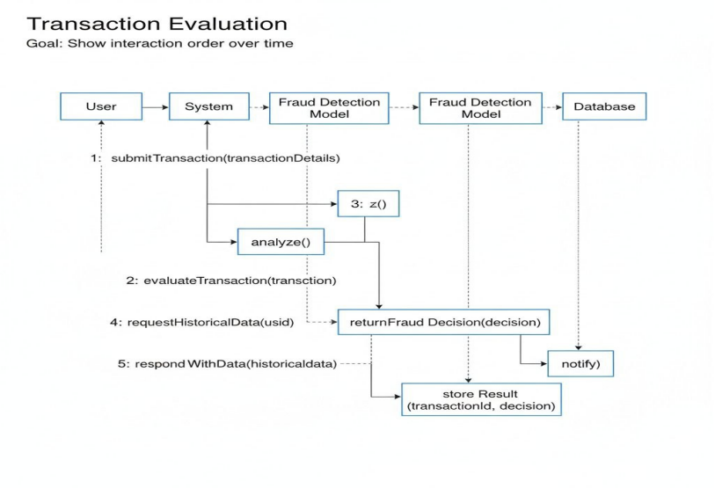
Fraud Detection
16 behavioral features — Temporal, Velocity, Financial, Geographic16 behavioral features — Temporal, Velocity, Financial, Geographic
Tier | Score | Color | Action
Low Risk | 0.0–0.49 | Green text | Normal checkout
Medium | 0.50–0.74 | Yellow text | Extra verification
High Risk | 0.75–1.0 | Red text | Blocked, admin review
This is a behavioral safety layer — not the core of the platform. It supports human decision-making, not replaces it.

Slide 27
Gap Analysis

Slide 28
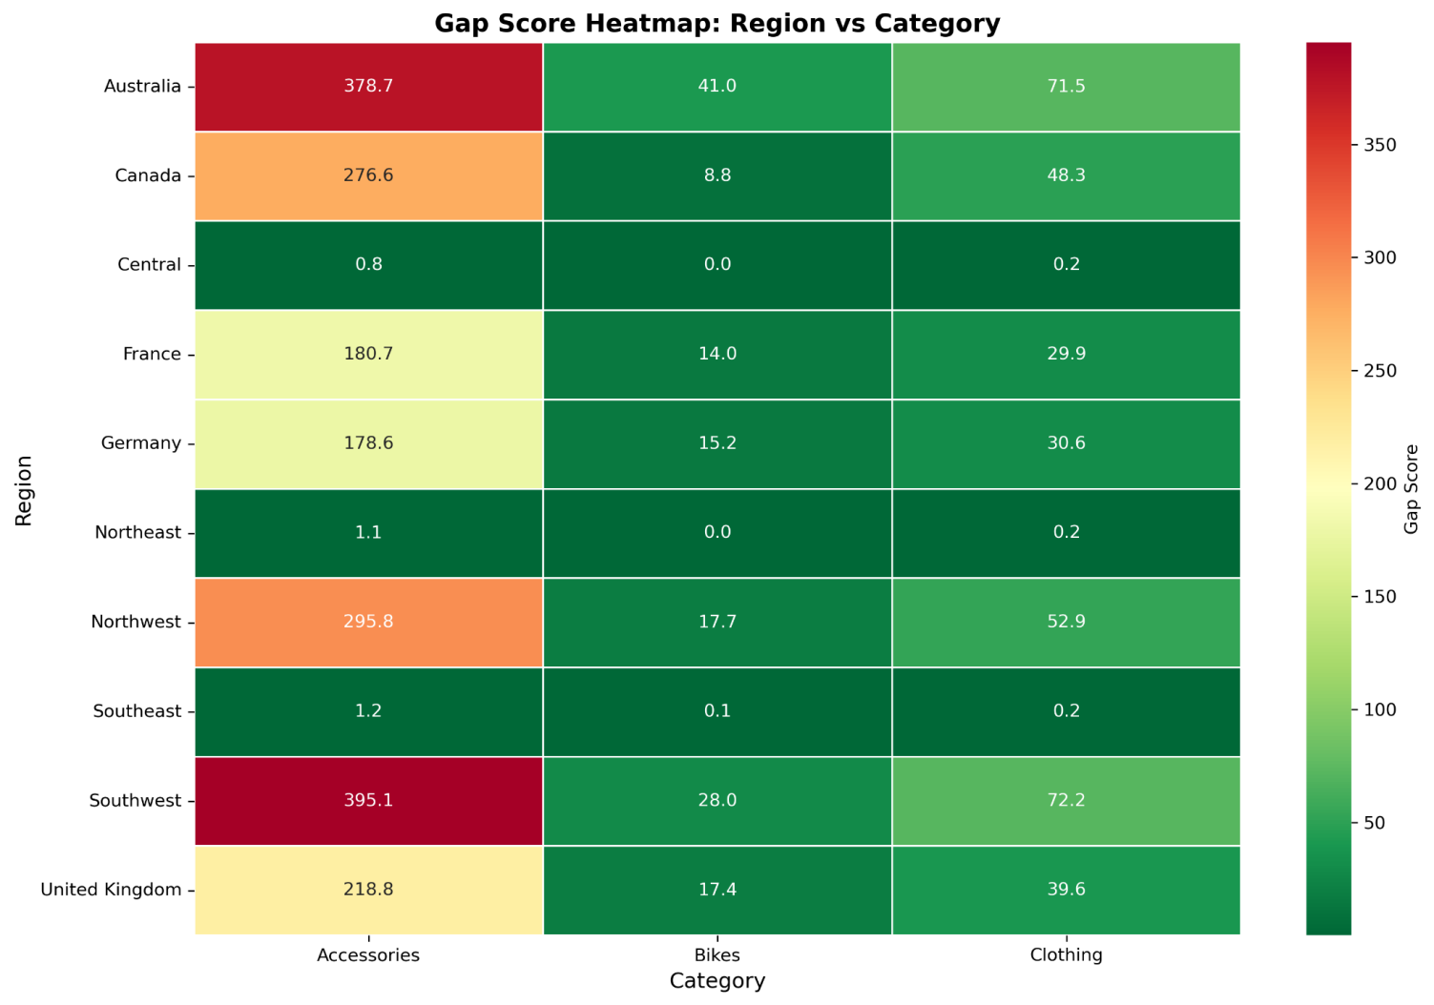
Gap Analysis
Gap Score | Severity | Action
< 50 | Low | Monitor
50-100 | Moderate | Incentivize owners
100-200 | High | Active recruitment
> 200 | Critical | Emergency campaign

Slide 29
Semester 1 Timeline

Slide 30
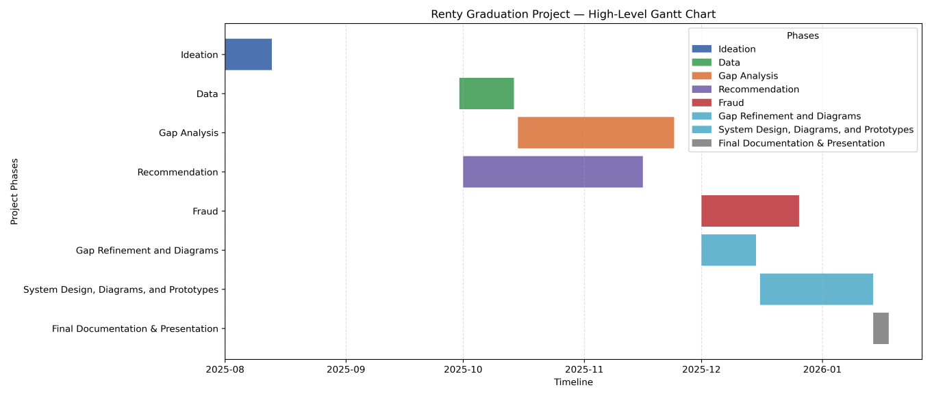
Semester 1 Timeline

Slide 31
Rental Lifecycle

Slide 32
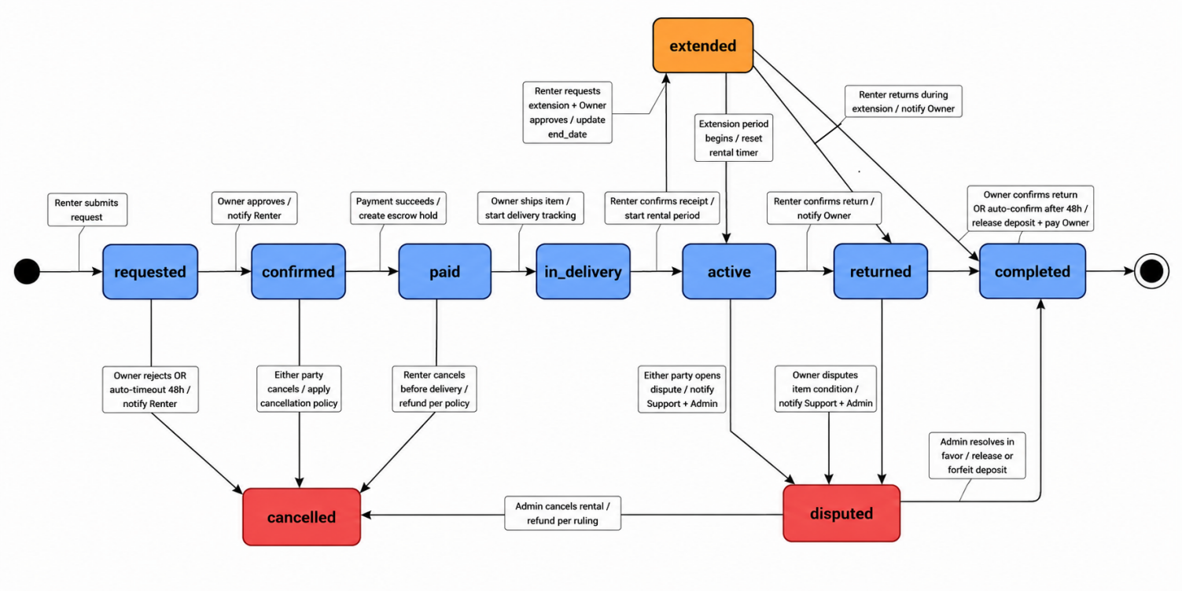
Rental Lifecycle
Every state transition is enforced at the database level using PostgreSQL ENUMs and check constraints.

Slide 33
Payment & Escrow

Slide 34
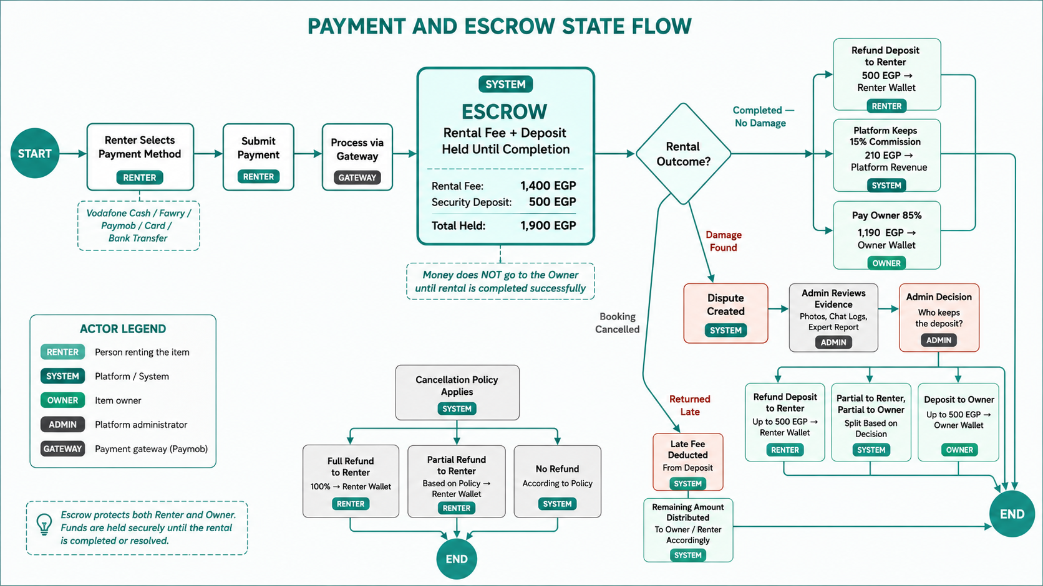
Payment & Escrow

Slide 35
Real Time
Communication

Slide 36
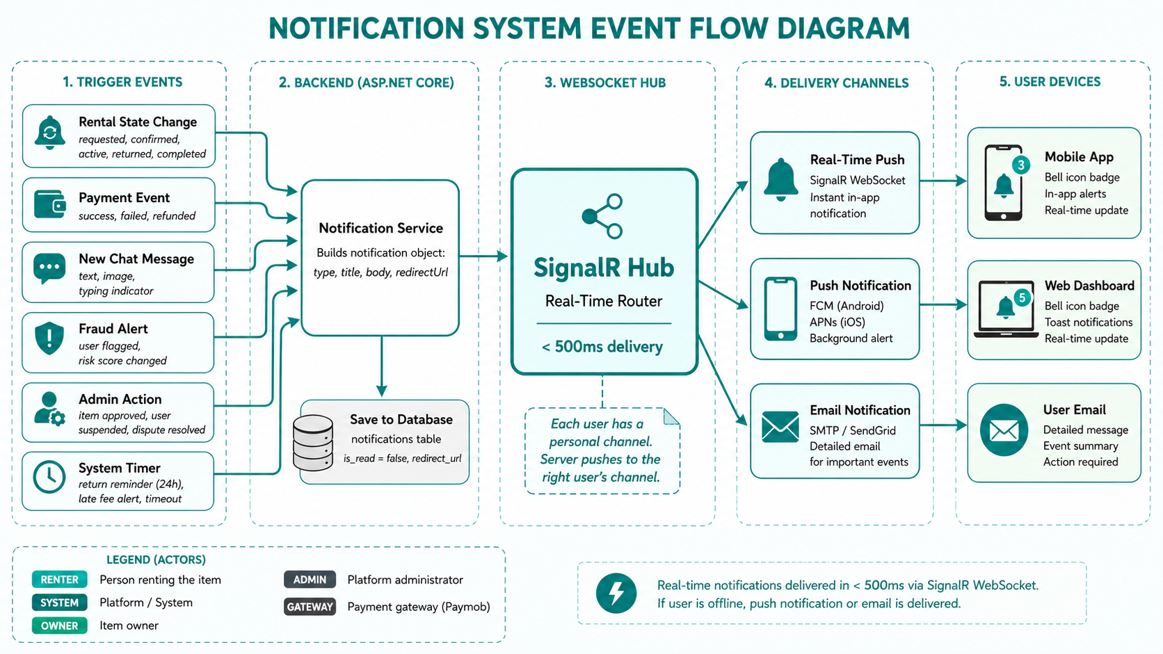
Real Time Communication
Event | Recipient | Trigger
Rental Confirmed | Renter | Owner approves request
Rental Started | Renter | Both confirm handover
New Message | Recipient | Other party sends chat
Return Reminder | Renter | 24h before end date
Late Fee Alert | Renter | Overdue detected
Dispute Opened | Both | User opens dispute

Slide 37
Operational Workflows

Slide 38
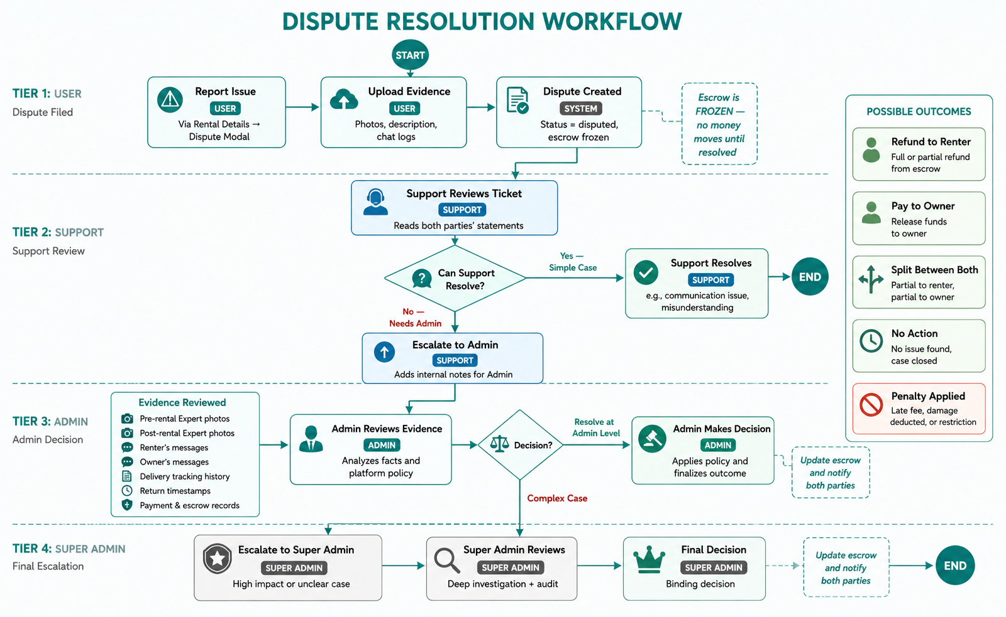
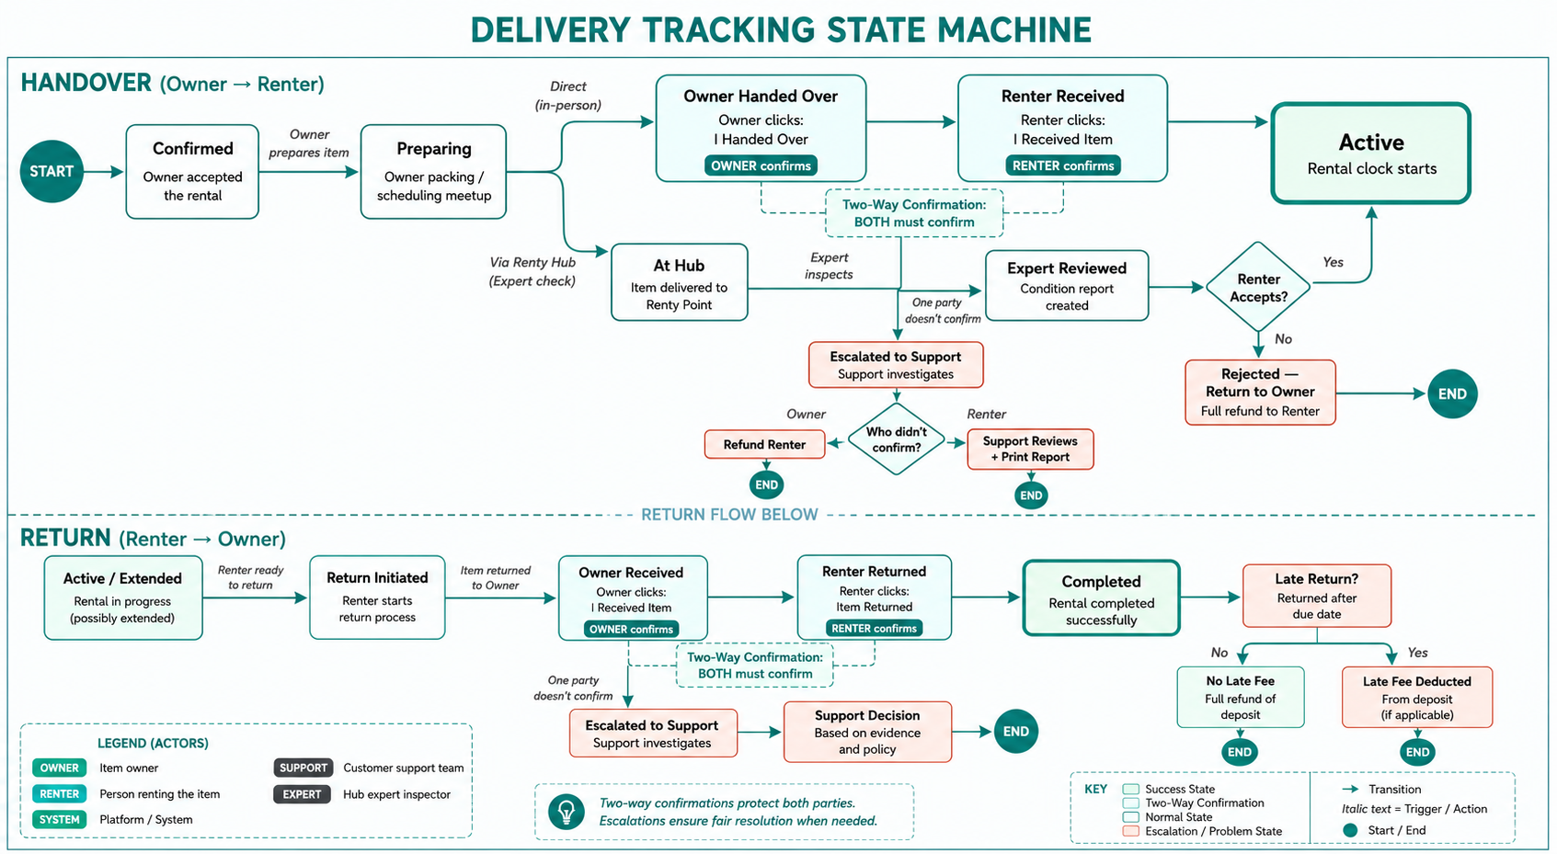
Operational Workflows

Slide 39
Trust Architecture

Slide 40

Trust Architecture
Escrow Payments
All money held by platform until rental completes
Renter protected: refund if owner doesn't deliver
Owner protected: deposit covers damage
Identity & Ratings
Expert Verification
Email + phone + ID verification
Dual rating system (renter rates owner, owner rates renter)
Fraud scoring as additional safety layer
Physical inspection at Renty Hubs
Pre-rental and post-rental condition reports
Same expert rule: consistency prevents collusion
Dispute Resolution
3-tier escalation: Support > Admin > Super Admin
Evidence-based: photos, chat logs, expert reports
Cancellation policies: Flexible / Moderate / Strict

Slide 41
Expert Hubs

Slide 42
Expert Hubs
Step 1: Owner
— Lists item, requests expert check
Step 2: Renty Hub
— Owner brings item to nearest hub
Step 3: Expert Inspects
— Condition report: photos, checklist, rating
Step 4: Approved
— Item listed as Expert Verified
Step 5: Post-Rental
— Same expert checks item on return
Continuity Rule: The SAME expert must perform both pre-rental and post-rental checks to prevent collusion and ensure accountability.

Slide 43
Smart Recommendations

Slide 44
Smart Recommendations
The Weekend Cyclist
- Friday 4PM: App opened
— System detects weekend pattern
The Diving Tourist
- Friday 5PM: Recommends Mountain Bike + Helmet bundle
- Tourist arrives in Dahab (detected via location/language)
- Saturday: User books
— System logs interaction
- System recommends: Diving package
— BCD + Regulator + Wetsuit
- Next Friday: Proactive notification
— Ready for this weekend?
- Season: Summer
— Water sports items promoted
Pattern: Every Fri–Sun --> target recommendations Friday afternoon
- Language: English
— Content served in English
Context-aware: Location + Season + Language = precise recommendations

Slide 45
Non-Functional Requirements

Slide 46
Non-Functional Requirements
Security
JWT + Refresh Tokens (15min / 7day)
RBAC: 6 roles, 7 policies
FluentValidation on every request
HTTPS/TLS 1.3 encryption
Parameterized queries (SQL injection prevention)
Performance
API response: < 200ms (p95)
WebSocket delivery: < 500ms
Angular lazy loading
EF Core query optimization
CDN for images (Cloudinary)
Scalability
Clean Architecture (4 layers)
CQRS pattern (read/write separation)
Connection pooling
Background services for batch jobs
Modular monolith (microservice-ready)

Slide 47
Localization

Slide 48
Non-Functional Requirements
Language Strategy
Currency Strategy
Primary: English (sports tourism — Dahab, Red Sea, Sinai)
Secondary: Arabic (local Egyptian users)
Architecture: Full i18n support built in
RTL layout support ready
Primary storage: EGP (Egyptian Pound)
Tourist display: USD/EUR conversion at checkout
Payment gateway: Paymob (international cards)
Owner always paid in EGP
Example: Climbing rope 200 EGP/day --> Tourist sees ~$4 USD/day

Slide 49
Semester 2 Timeline

Slide 50
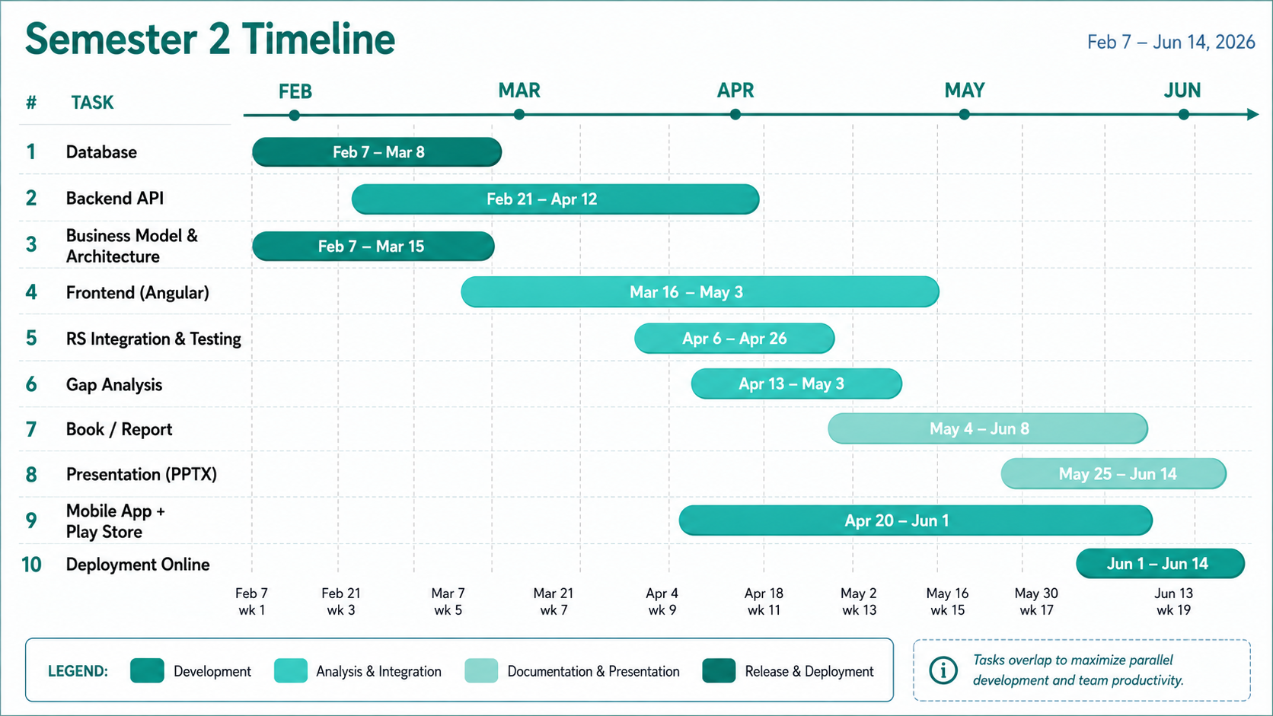

Slide 51
Thank you
Represented By :
Yasser Ashraf Mohammed
Hamza Hussain Youssef
Ahmad Khlifa Abdulraouf
Moaz Moustafa Abdul Hamid
Moamen Ahmed Mohammed
Abdul Rahman Hesham Ragab
Supervised By
Dr Mohammed Khamis

